Slide 1
Introduction to Statistical Methods
ISM Team

Slide 2
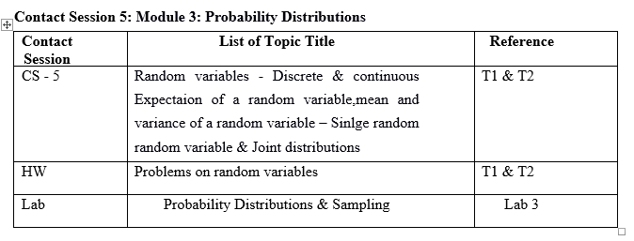
Session 5
(23rd
August 2026)
Random Variables

Slide 3
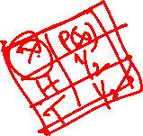
Random Variables
A random variable is a variable that assumes numerical values associated with the random outcome of an experiment, where one (and only one) numerical value is assigned to each sample point.
In mathematical language, a random variable is a function whose domain is the sample space and whose range is the set of real numbers.

Slide 4
Types of Random Variables
A discrete random variable can assume a countable number of values.
  Number of steps to the top of the Eiffel Tower
  Number of Heads obtain after tossing two coins simultaneously
A continuous random variable can assume any value along a given interval of a number line.
  The time a tourist stays at the top once s/he gets there.
  The height of a person can take any value within a certain range (e.g., 150 cm to 200 cm),

Slide 5
Identify which of the following variables are discrete and which are continuous:
The number of books in a library. (Discrete / Continuous)
The weight of a watermelon in kilograms. (Discrete / Continuous)
The amount of rainfall in a day (in millimeters). (Discrete / Continuous)
The number of passengers on a bus. (Discrete / Continuous)
The temperature of a cup of coffee (in °C). (Discrete / Continuous)
The number of goals scored in a football match. (Discrete / Continuous)
The length of a bridge (in meters). (Discrete / Continuous)
The number of steps you take in a day. (Discrete / Continuous)
The time it takes to bake a cake (in minutes). (Discrete / Continuous)

Slide 6
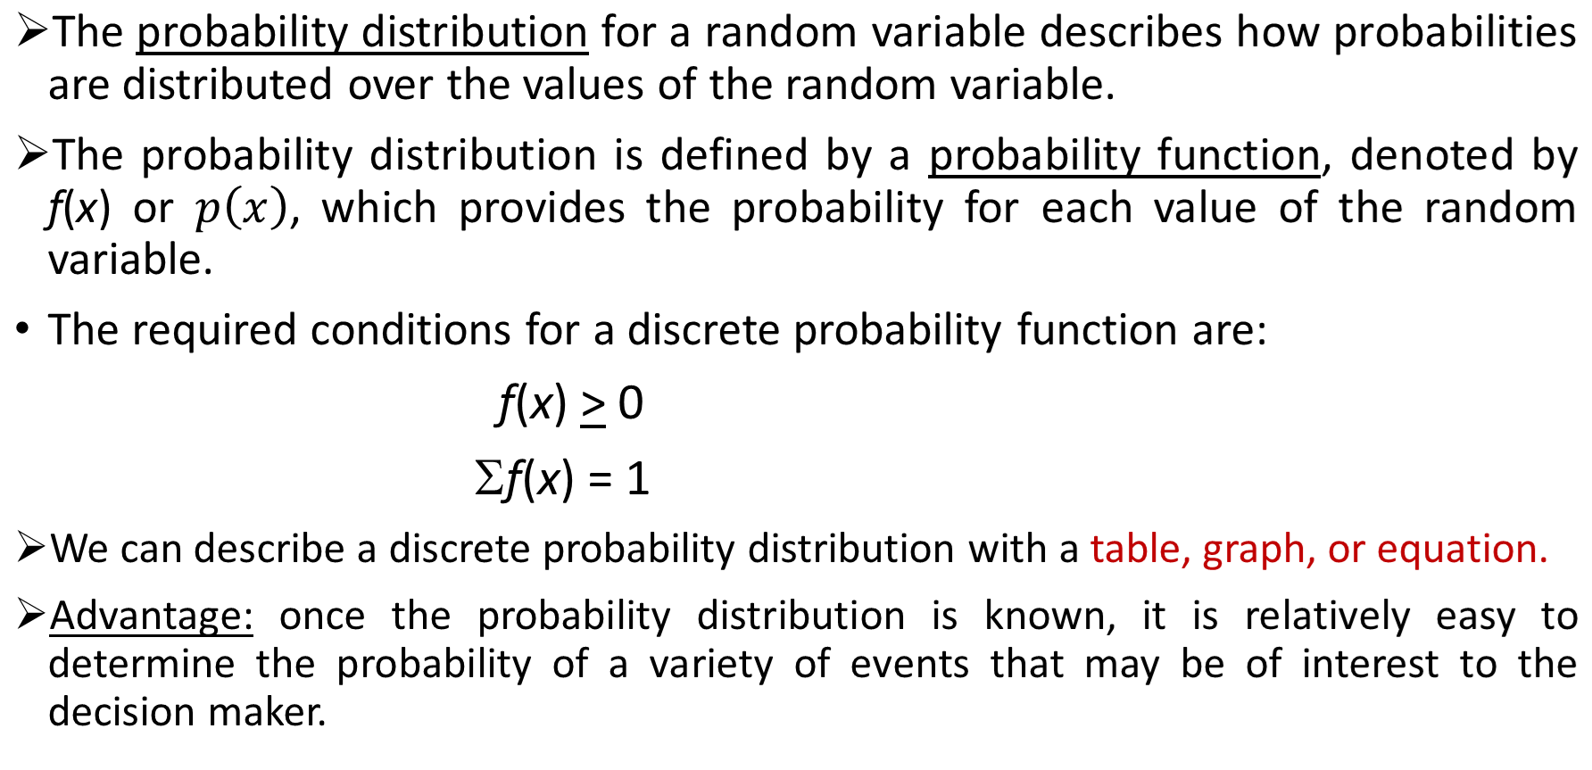

Discrete Probability Distributions

Slide 7
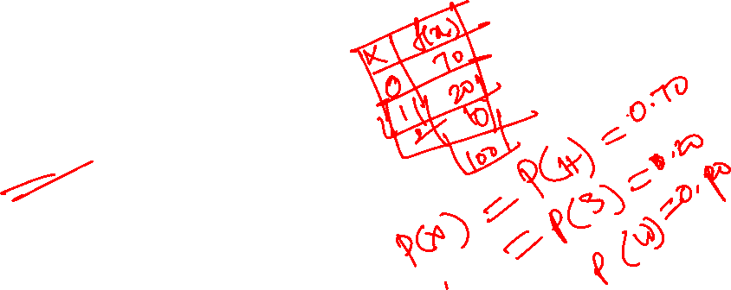
Probability Distributions for Discrete Random Variables
A company monitors employees’ daily health status. Each day, an employee falls into one of the following mutually exclusive categories:
X = 0 → Healthy & Present (H)
X = 1 → Sick Leave (S)
X = 2 → Work-from-Home (Medical Reason) (W)
Probabilities: P(H) = 0.70, P(S) = 0.20, P(W) = 0.10
Properties:
• P(X) ≥ 0
• Sum of probabilities = 1

Slide 8
Discrete Uniform Probability Distribution
The discrete uniform probability distribution is the simplest example of a discrete probability distribution given by a formula.
The discrete uniform probability function is
f(x) = 1/n
where:
n = the number of values the random variable may assume
Note that the values of the random variable are equally likely.
Example: A discrete RV X: No. on a dice has the uniform probability
f(x) = 1/6 for x = 1,2,3,4,5,6

Slide 9
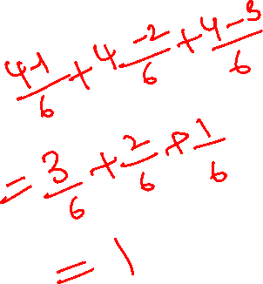

Example
Suppose a student takes 1, 2, or 3 attempts to pass a driving test. Let the probability function be:
Is this a valid probability function?

Slide 10
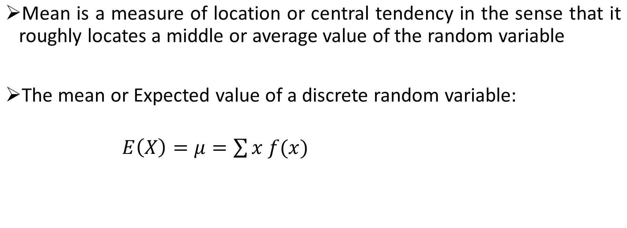
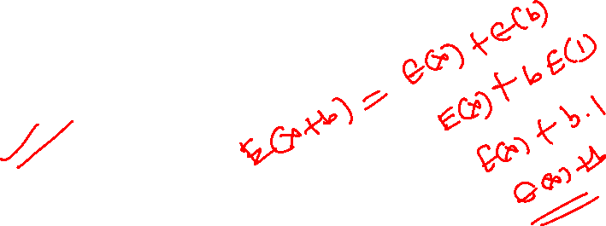
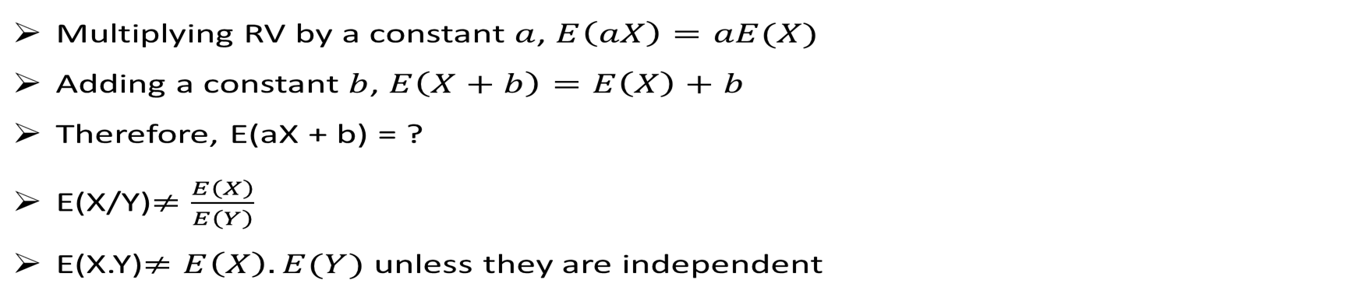
Mathematical Expectation

Slide 11
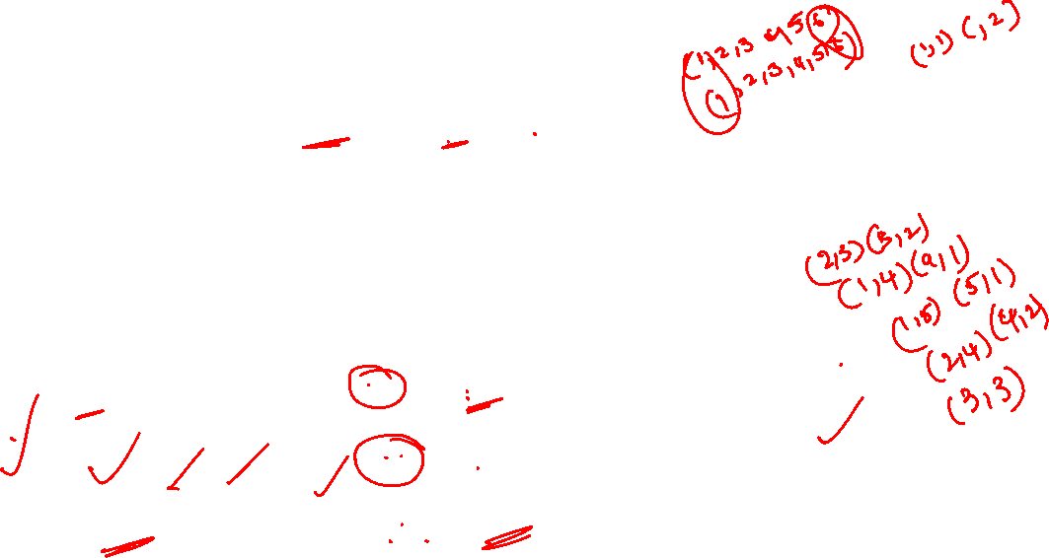
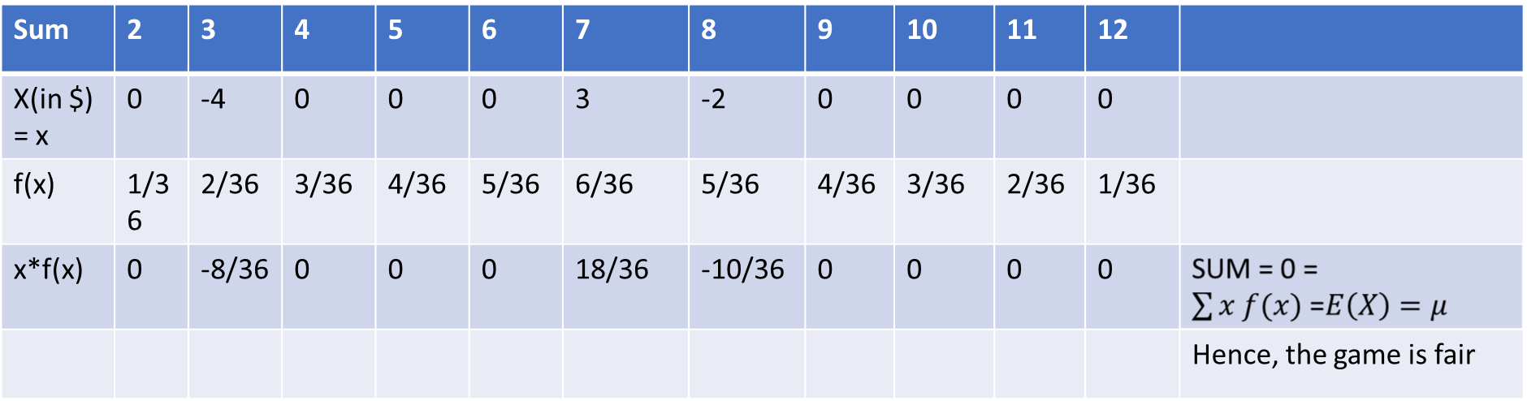

Example:
A game is played by two person A and B as follows:
“A throws two dice. If the sum is 7 he wins $3 from B. If the sum is 8, he loses $2 and if the sum is 3, he loses $4, otherwise no money changes hand. Is this a fair game?”
A game is said to be fair if the expected gain is zero. In order to check it, let the random variable X = gain of A from B which takes values with probability distribution as follows:

Slide 12
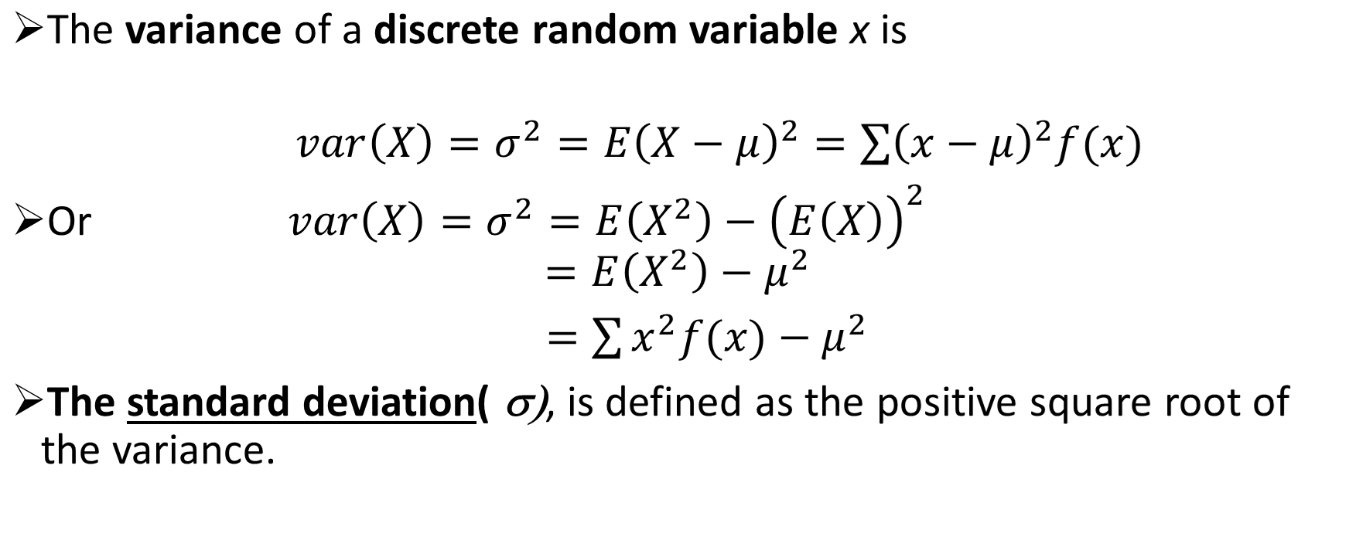

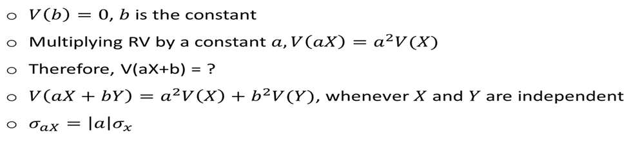
Variability of Discrete Random Variables

Slide 13

Example:
A fast-food restaurant manager analyzes how many cars are typically in line at the drive-thru at lunch hour. Let the random variable X represent the number of cars in line when a customer arrives. Find the mean, standard deviation and variance. Historical data shows:
Number of Cars (x) | Probability P(X=x)
0 (no wait) | 0.10
1 car | 0.30
2 cars | 0.40
3 cars | 0.15
4 cars | 0.05

Slide 14
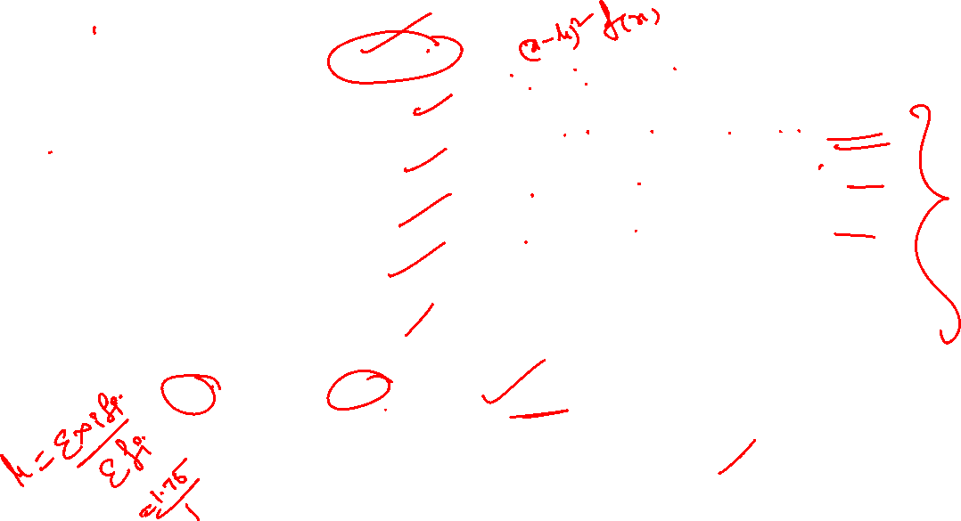
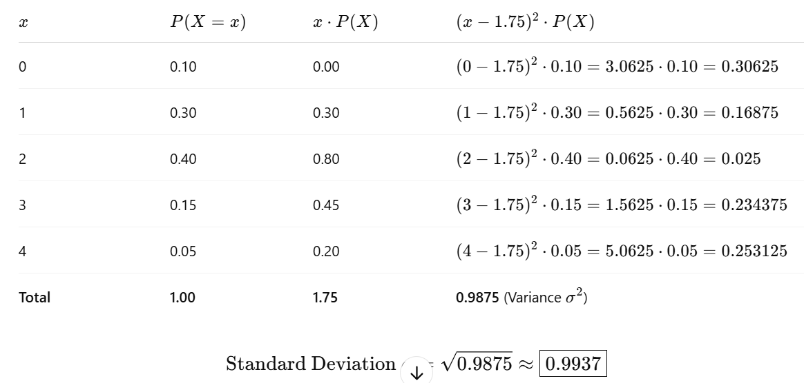
Expected value & SD:

Slide 15

Cumulative Probability distribution Function
If X is a discrete random variable which assumes values x = x₁, x₂, x₃,..x_{i}, …x_{n} with their corresponding probabilities f(x) = f₁, f₂,f₃,…f_{i},…f_{n} respectively then the cumulative distribution function (CDF) of the RV X is defined as F(x) = P(X < x).
Specifically,
F(x₁) = P(X < x₁) = P(X=x₁)=f₁
F(x₂) = P(X < x₂) = P(X=x₁)+ P(X=x₂) =f₁+f₂
F(x₃) = P(X < x₃) = P(X=x₁)+ P(X=x₂) + P(X=x₃) =f₁+f₂+f₃
…………………………………………………………………….
……………………………………………………………………
F(x_{n})=P(X<x_{n}) = P(X=x₁)+ P(X=x₂) +..+ P(X=x_{n}) =f₁+f₂+…+f_{n} = 1 (=Total probability)

Slide 16
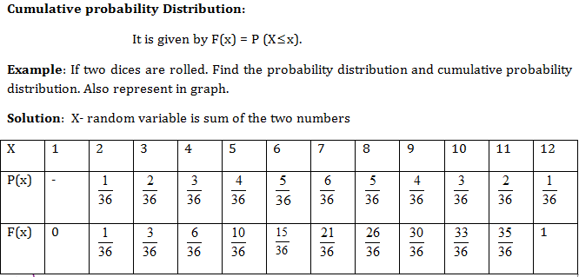

Cumulative Distribution for Discrete Data

Slide 17
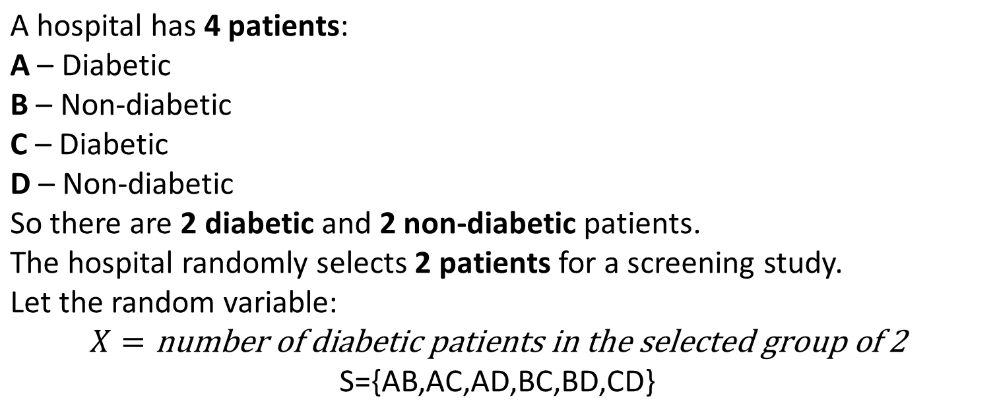
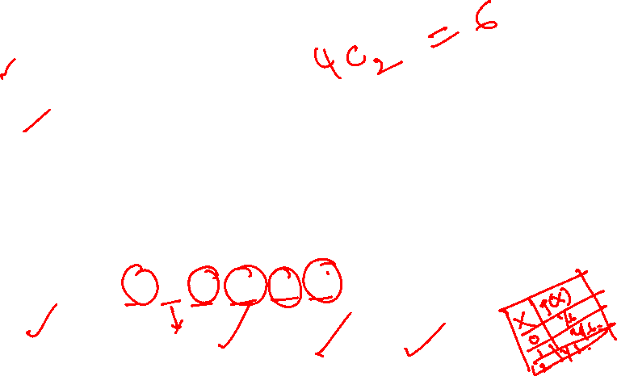

Example: 1

Slide 18
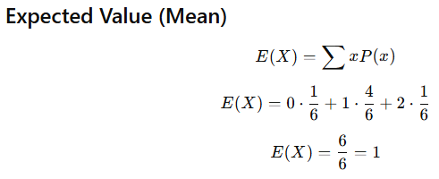


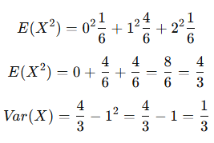
Solution:

Slide 19
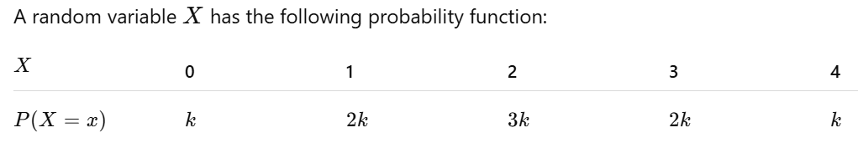
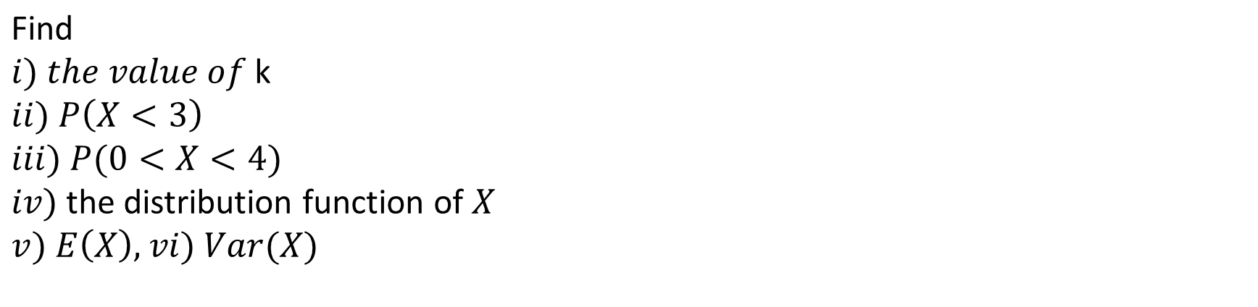
Example: 2

Slide 20
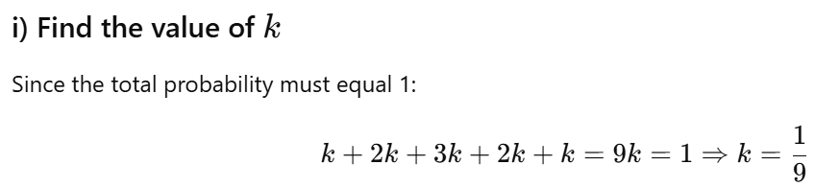
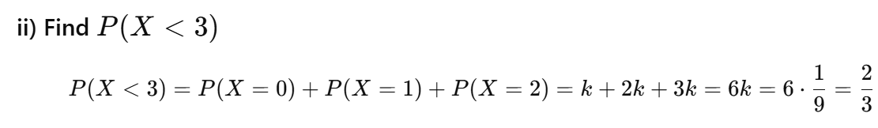
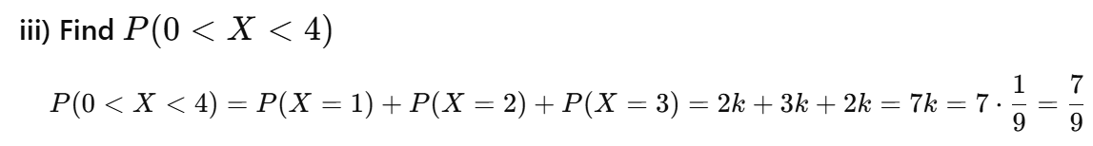
Solution:

Slide 21
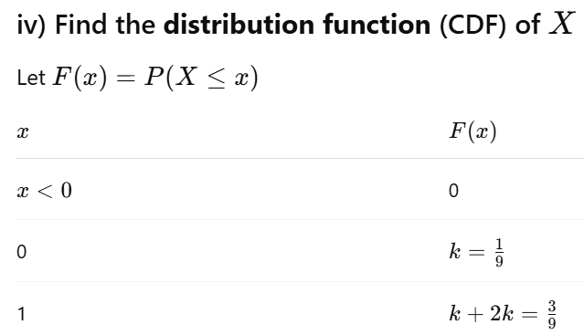
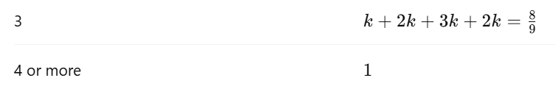

Slide 22
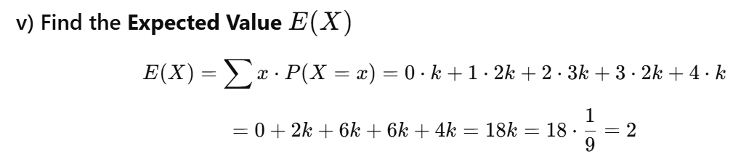
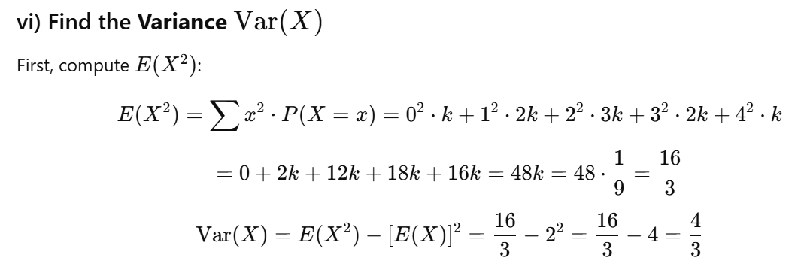

Slide 23
Continuous Probability Distributions
A continuous random variable can assume any value in an interval on the real line or in a collection of intervals.
It is not possible to talk about the probability of the random variable assuming a particular value.
Instead, we talk about the probability of the random variable assuming a value within a given interval.
The probability of the random variable assuming a value within some given interval from x₁ to x₂ is defined to be the area under the graph of the probability density function between x₁ and x₂.

Slide 24
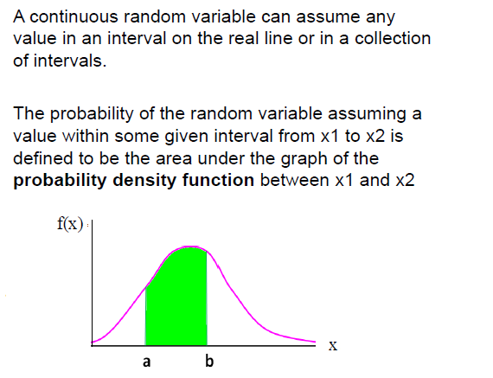
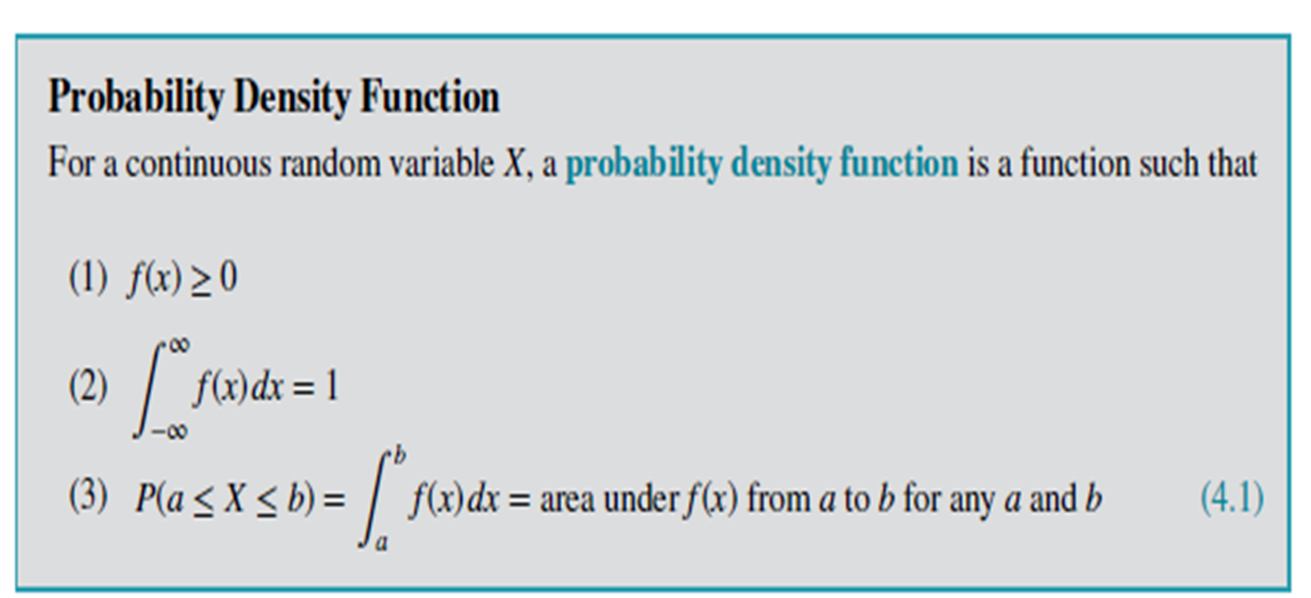
Continuous Random Variables
Example:
Height of students in a class
Amount of ice tea in a glass
Change in temperature throughout a day
Price of a car in next year

Slide 25
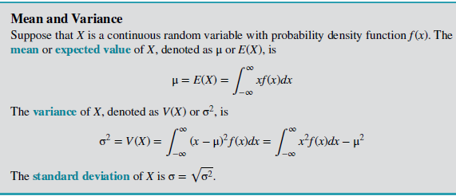
Continuous Random Variables

Slide 26
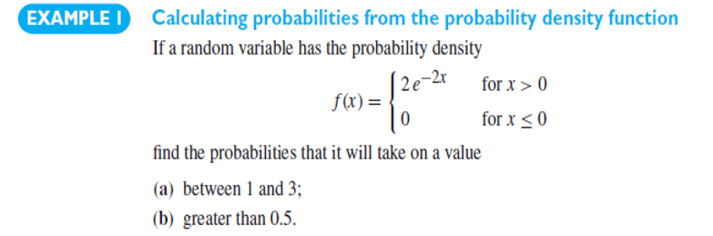
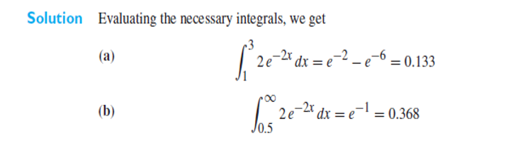
Continuous Random Variables

Slide 27
Example 2
The Pdf of a random variable is given by f(x) = x for 0<x<1
= 2-x for 1< x <2
= 0, elsewhere
Determine, mean, variance, standard deviation
P(x lies in between 0.2 and 0.8)
P(x lies in between 0.6 and 1.2)

Slide 28
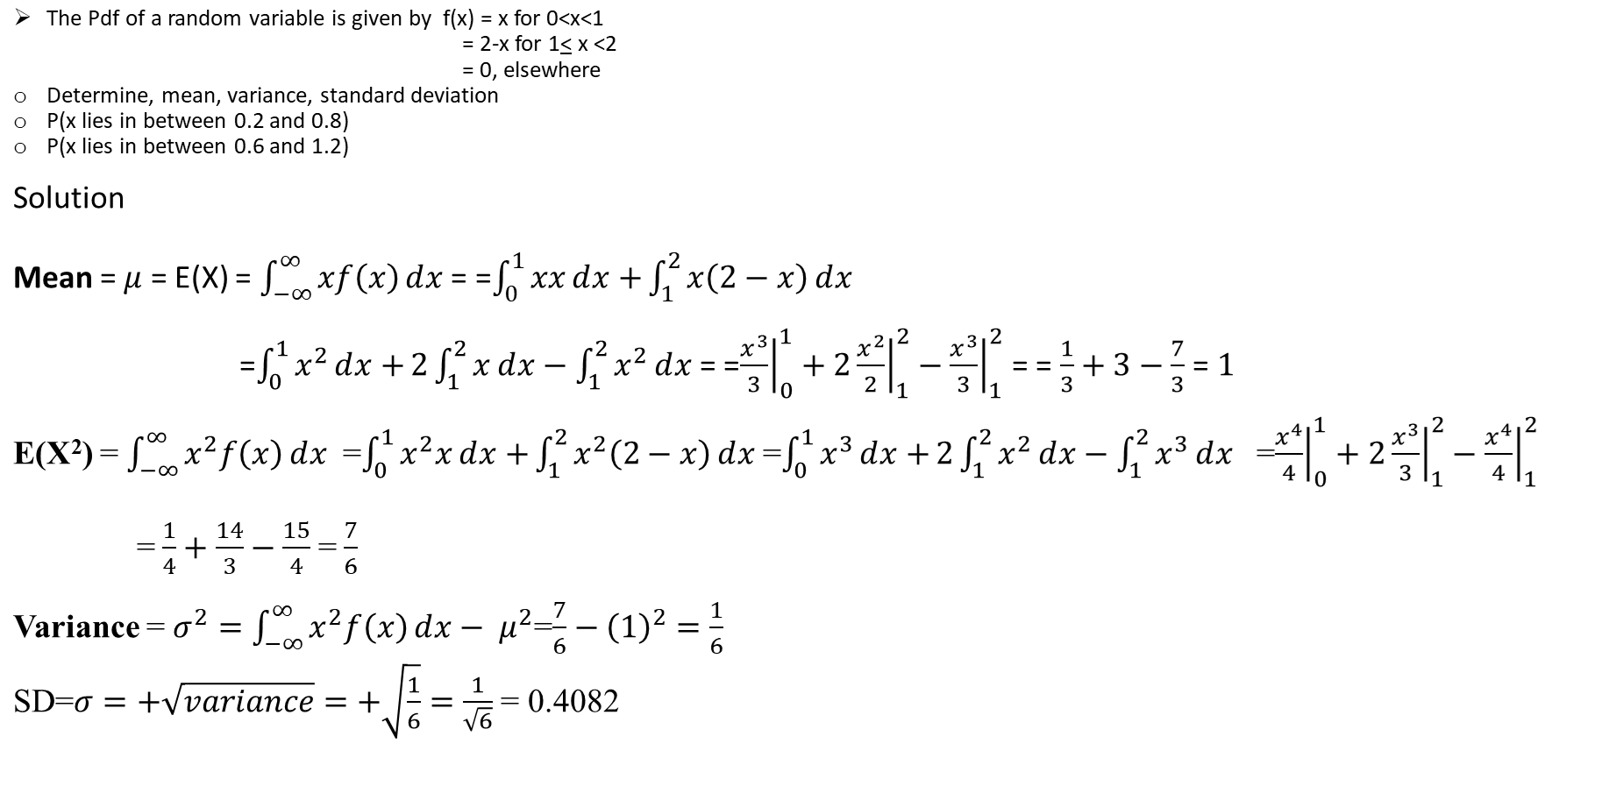
Solution

Slide 29
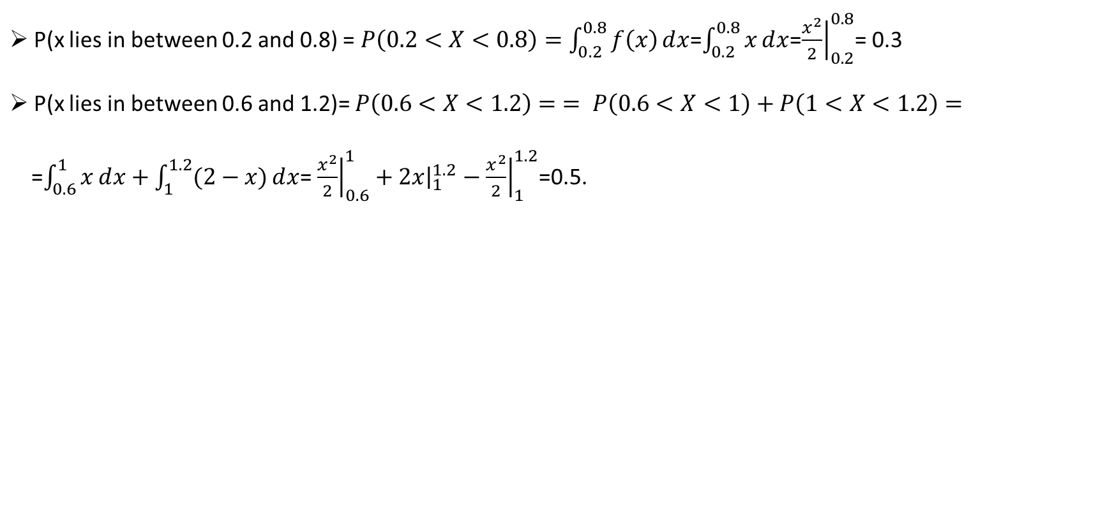

Slide 30
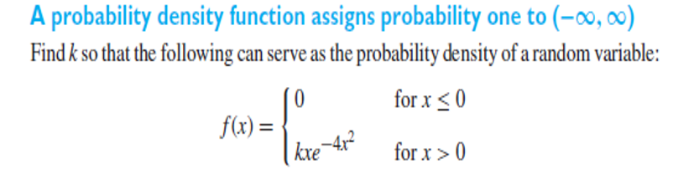
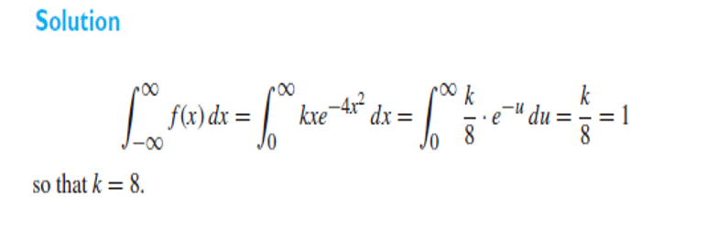
Example 3:

Slide 31
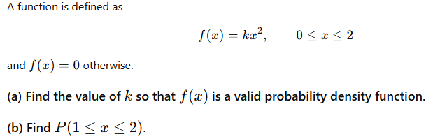
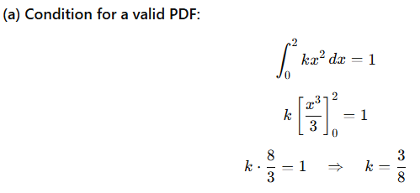
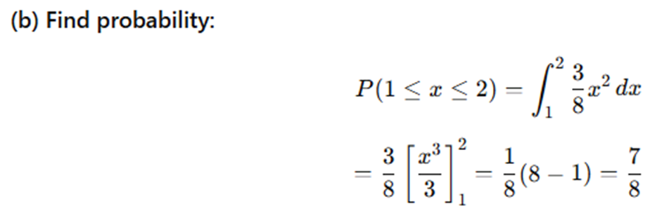
Practice Problems
Solution

Slide 32
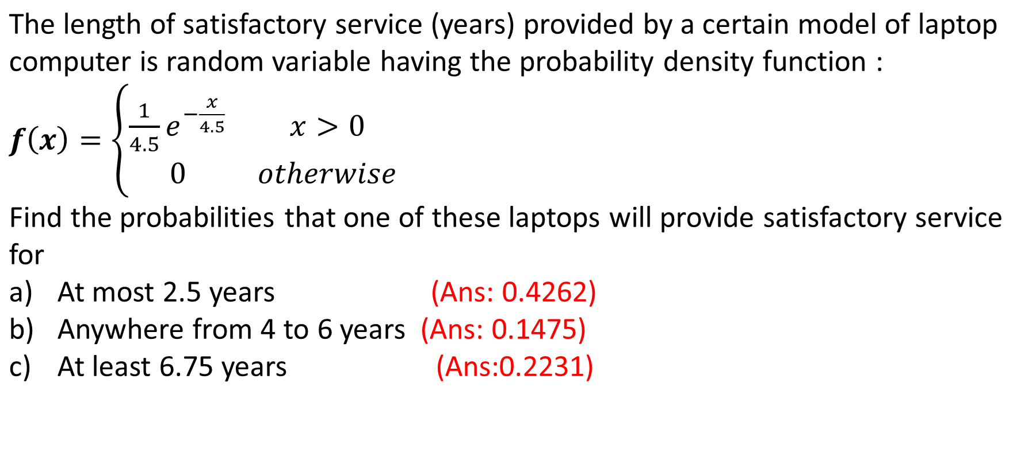

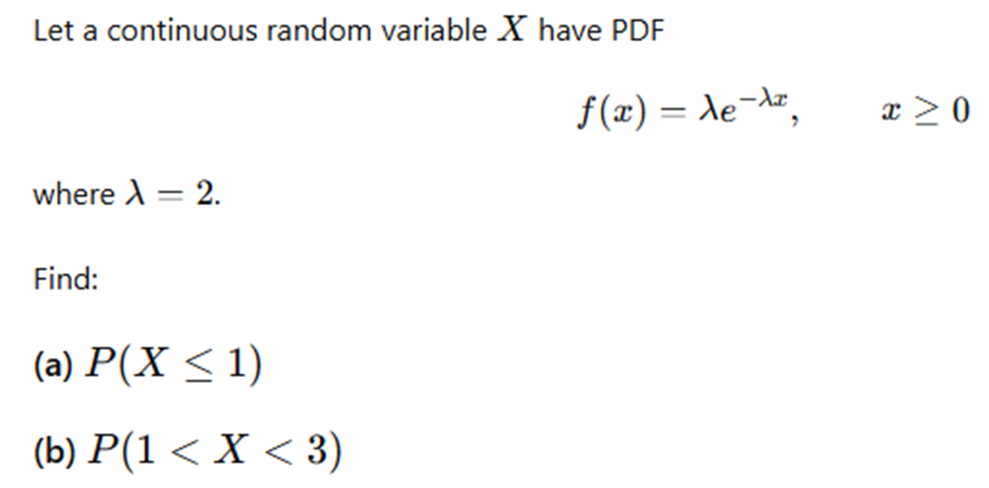
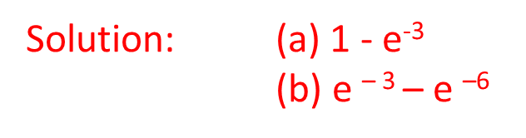
Problem 2:

Slide 33
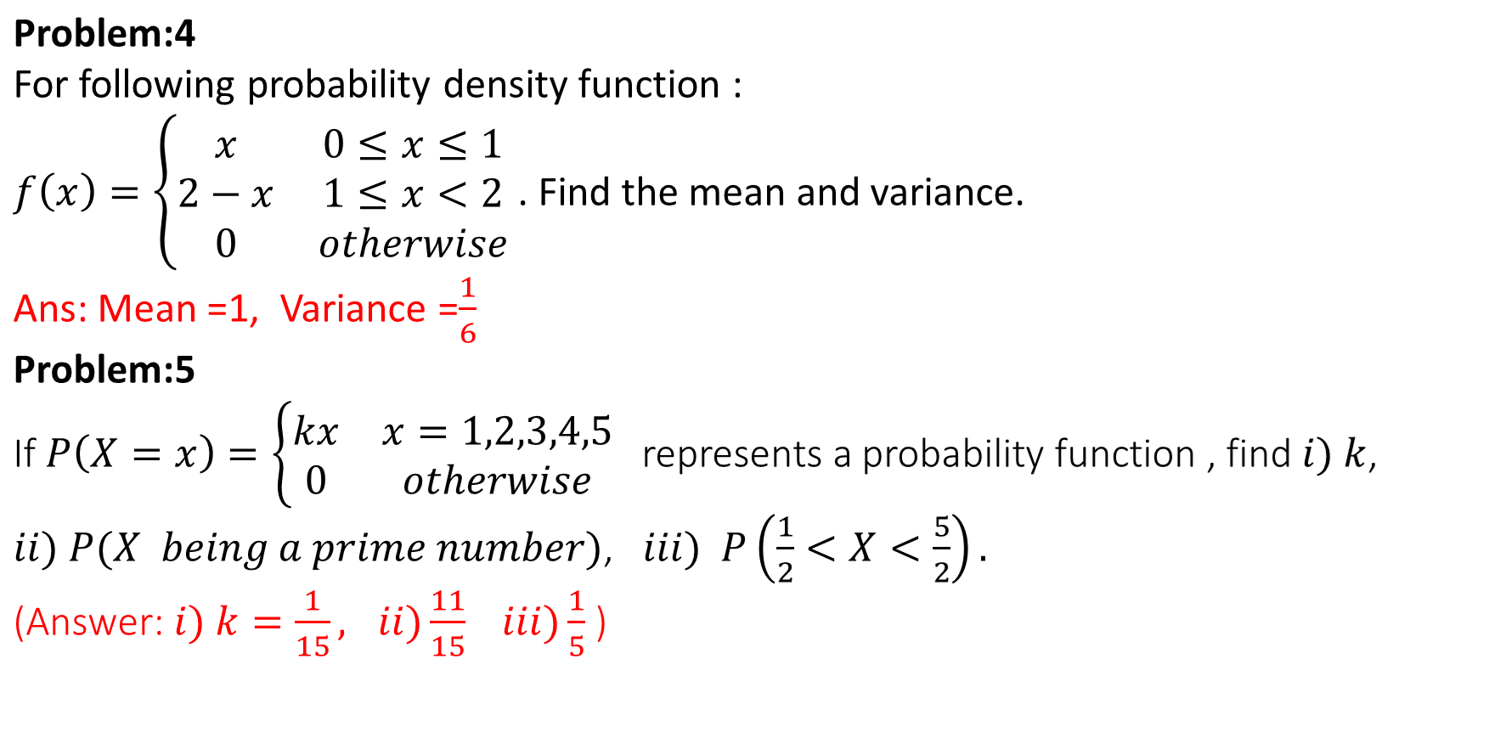

Slide 34
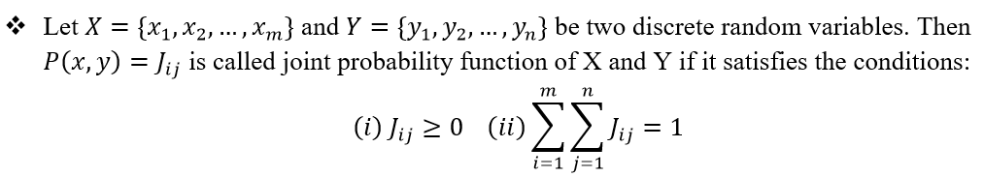
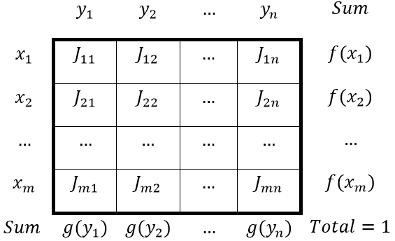
Joint Probability Distribution Function

Slide 35
If X and Y are discrete random variables, the joint probability distribution of X and Y is a description of the set of points (x,y) in the range of (X,Y) along with the probability of each point.
The joint probability distribution of two discrete random variables is sometimes referred to as the bivariate probability distribution or bivariate distribution.
Thus, we can describe the joint probability distribution of two discrete random variables is through a joint probability mass function
f(x,y)=P(X=x,Y=y)

Slide 36
We often want to determine the joint probability of two variables, such as X and Y. Suppose we are able to determine the following information for education (X) and age (Y) for all Indian citizens based on the census.
Age (Y): Education (X) | 30 | 45 | 70
None 0 | .01 | .02 | .05
Primary 1 | .03 | .06 | .10
Secondary 2 | .18 | .21 | .15
College 3 | .07 | .08 | .04

Slide 37
Each cell is the relative frequency (f/N).
We can define the joint probability distribution as:p(x, y)= Pr(X = x and Y = y)
Example: what is the probability of getting a 30 year old college graduate?
p(x,y) = Pr(X=3 and Y=30) = .07
We can see that: p(x) = Σ_{y} p(x,y)
p(x=1) = .03 + .06 + .10 = .19
Age (Y): Education (X) | 30 | 45 | 70
None 0 | .01 | .02 | .05
Primary 1 | .03 | .06 | .10
Secondary 2 | .18 | .21 | .15
College 3 | .07 | .08 | .04

Slide 38
Marginal Probability
We call this the marginal probability because it is calculated by summing across rows or columns and is thus reported in the margins of the table.
We can calculate this for our entire table.
Age (Y): Education (X) | 30 | 45 | 70 | p(x)
None: 0 | .01 | .02 | .05 | .08
Primary: 1 | .03 | .06 | .10 | .19
Secondary: 2 | .18 | .21 | .15 | .54
College: 3 | .07 | .08 | .04 | .19
p(y) | .29 | .37 | .34 | 1

Slide 39

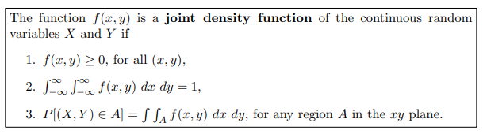
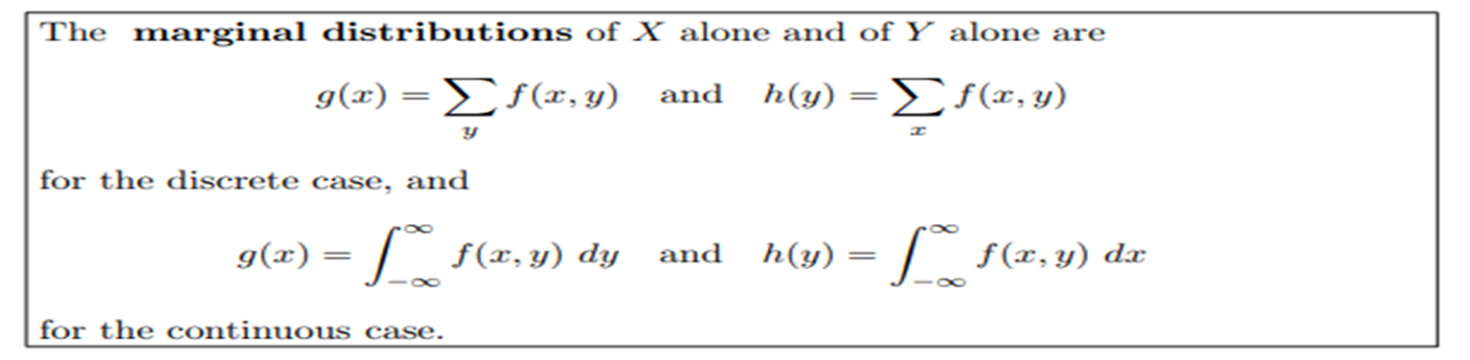
Joint Density Function & Marginal Dis

Slide 40
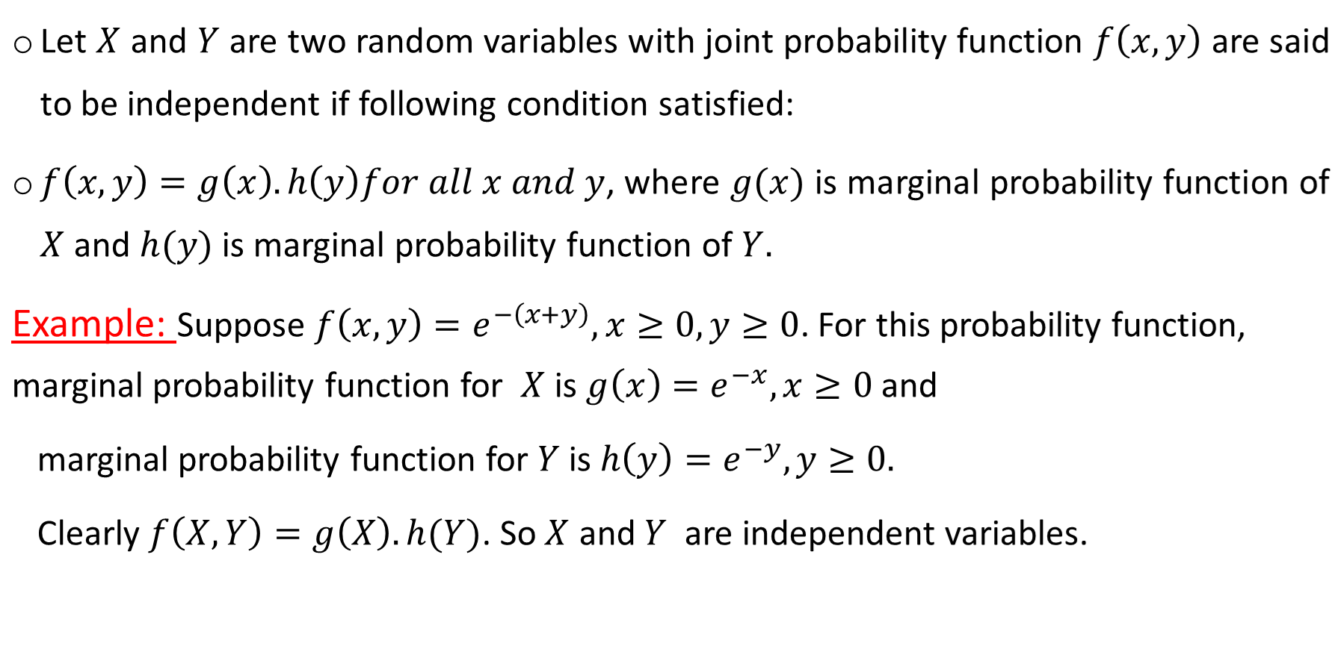
Independent Random Variables

Slide 41
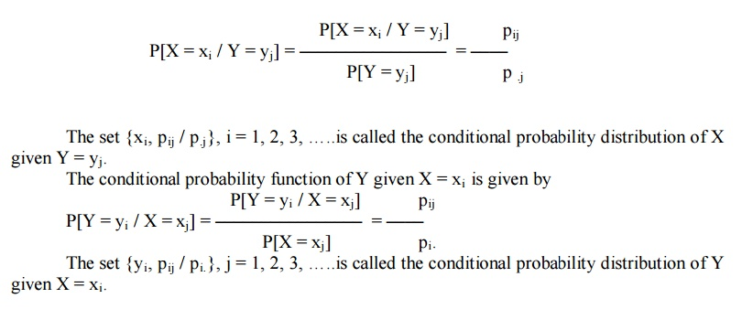
Conditional Probability Distribution Function
Discrete Case:

Slide 42

Continuous Case

Slide 43

Example 1:
You want to compute the probability that a patient has the flu given they have a fever.
Let:
D∈{Flu, No Flu} : Disease (target variable)
S∈{Fever, No Fever} : Symptom (observed variable)
You are given the joint distribution from past data:
Compute the conditional probability distribution: P(D∣S=Fever)

Slide 44


Solution
Compute the marginal probability P(S=Fever):
Compute the Conditional probability:
Final Answer:

Slide 45





Example 2:
Solution:

Slide 46





Cont.

Slide 47






Example 3:
Two machines in a factory produce defective items. Let:
X: Number of defective items from Machine A (can be 0 or 1)
Y: Number of defective items from Machine B (can be 0, 1, or 2)
The joint probability mass function of X and Y is given below:

Slide 48


Solution:
5.

Slide 49



Example 4:
Solution:

Slide 50

Example 5:
Verify that f(x, y) is a valid joint probability density function
Find the marginal densities fX(x) and fY(y).
Compute P(X<0.5, Y>0.5) — i.e., probability that fewer wild images but more domestic images show claws
Are X and Y independent?
Compute the expected values E(X), E(Y), and E(XY).

Slide 51



Solution:
= 0.1875

Slide 52



Solution:

Slide 53












Example 6:
Solution:

Slide 54

Cont.

Slide 55

Practice Problems-set 2
X Y | 2 | 4
1 | 0.10 | 0.15
3 | 0.20 | 0.30
5 | 0.10 | 0.15

Slide 56



Slide 57


Slide 58
Thank You

